Slide 1


CS106A: Programming Methodologies

Slide 2
Chris Piech
My parents are interesting folks
I originally concentrated in graphics and worked at Pixar
Childhood: Nairobi, Kenya
High School: Kuala Lumpur, Malaysia
Stanford University Ph.D. in Neural Networks
Research lab on AI for Social Good
The problem I really want to solve is to make high quality more education accessible

Slide 3
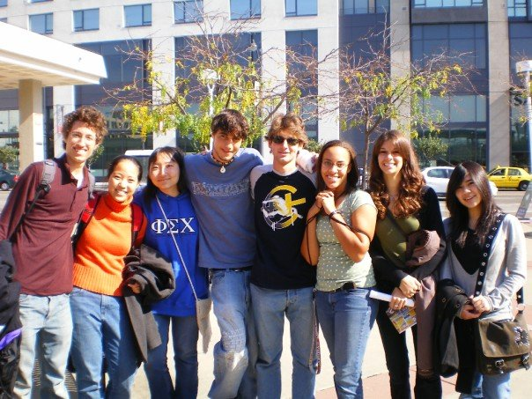
Chris Piech
11 years ago to this day, I was sitting in your seats

Slide 4
Head TA: Nick Troccoli

Slide 5
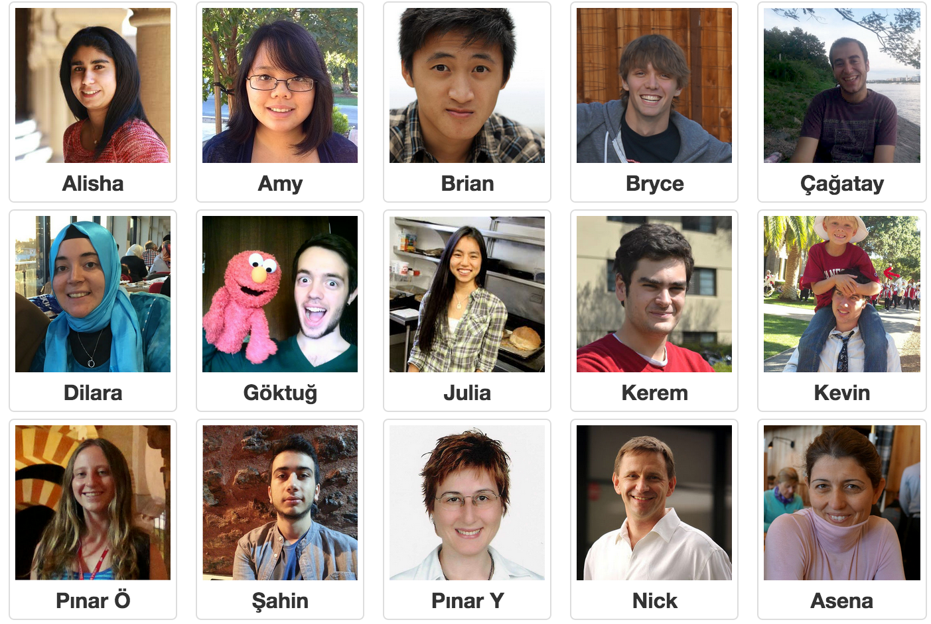
Section Leaders

Slide 6
Who are you?

Slide 7
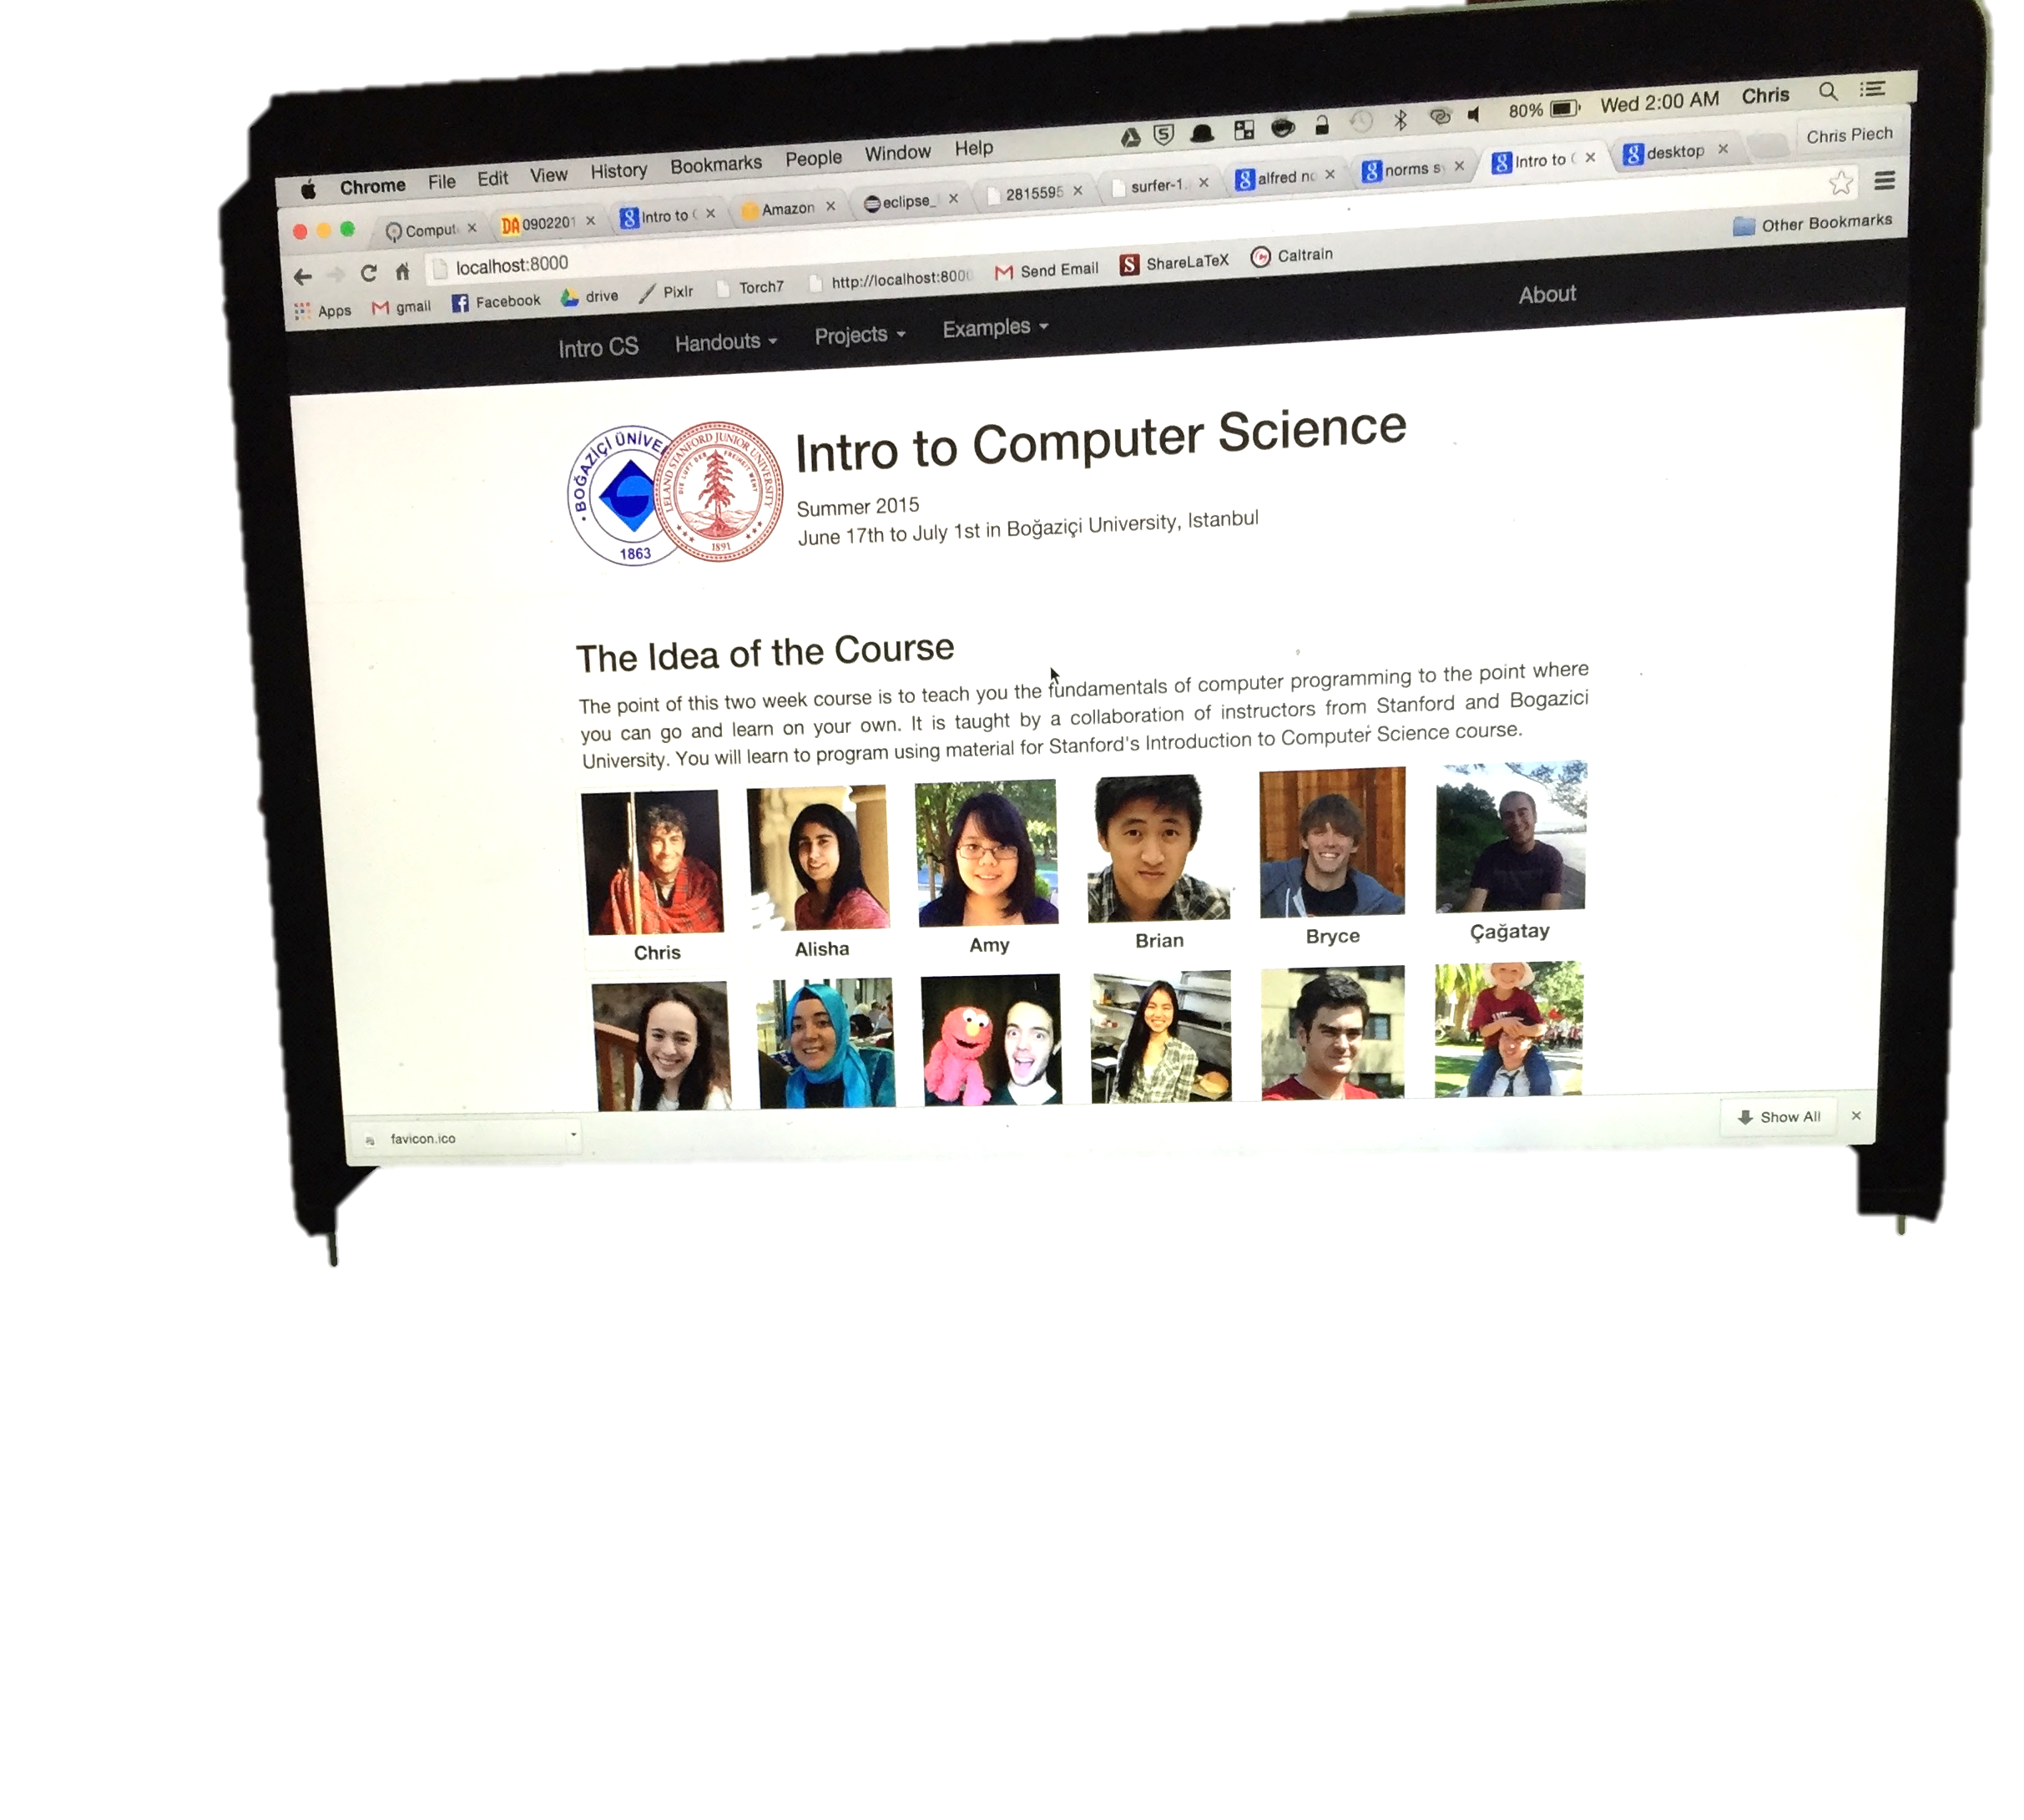

Prerequisite Test

Slide 8
Course mechanics
(this is a light version. Please read the handout for details).

Slide 9
Course Website
http://cs106a.stanford.edu

Slide 10
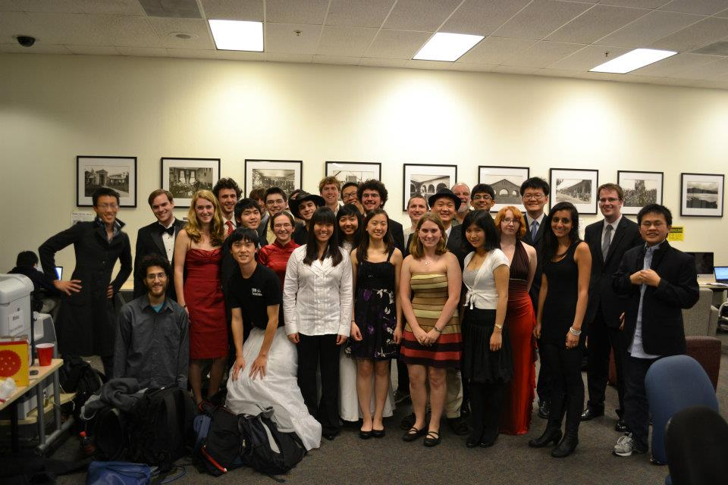
Lectures and Sections
Weekly 50-min section led by awesome section leaders (the backbone of the class!)
Signups begin on Thursday at 5:00pm and close Sunday at 5:00pm

Slide 11
Office Hours
LaIR: 6pm until midnight Sunday through Thursday
(starting next Sunday)

Slide 12


Grading Scale
Functionality and style grades for the assignments use the following scale:
A submission so good it “makes you weep.”
Exceeds requirements.
Satisfies all requirements of the assignment.
Meets most requirements, but with some problems.
Has more serious problems.
Is even worse than that.
Better than nothing.

Slide 13
What we will ask you to do
*Two free late days

Slide 14
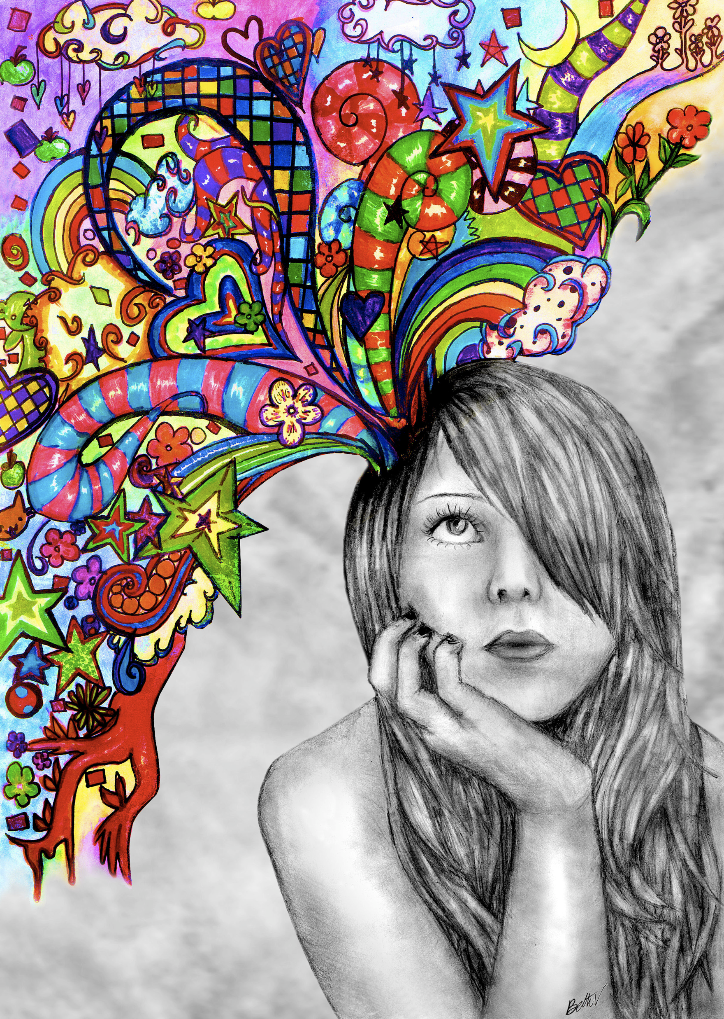
Optional Contest

Slide 15
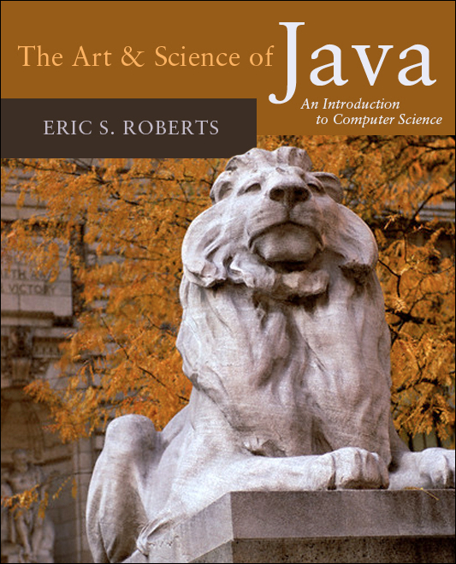
Textbook
The Art & Science of Java by Eric Roberts
written here at Stanford
tailored to this course
a valuable reference
usable on open-book exams
Karel the Robot Learns Java
First week of material

Slide 16
CS106A Units
Start Here
Average about 10 hours / week for assignments
Are you an
undergrad or
SCPD
student?
Do you want
to take CS106A for
fewer units?
No
Yes
3 Units
-or-
4 Units
Yes
No
5 Units

Slide 17
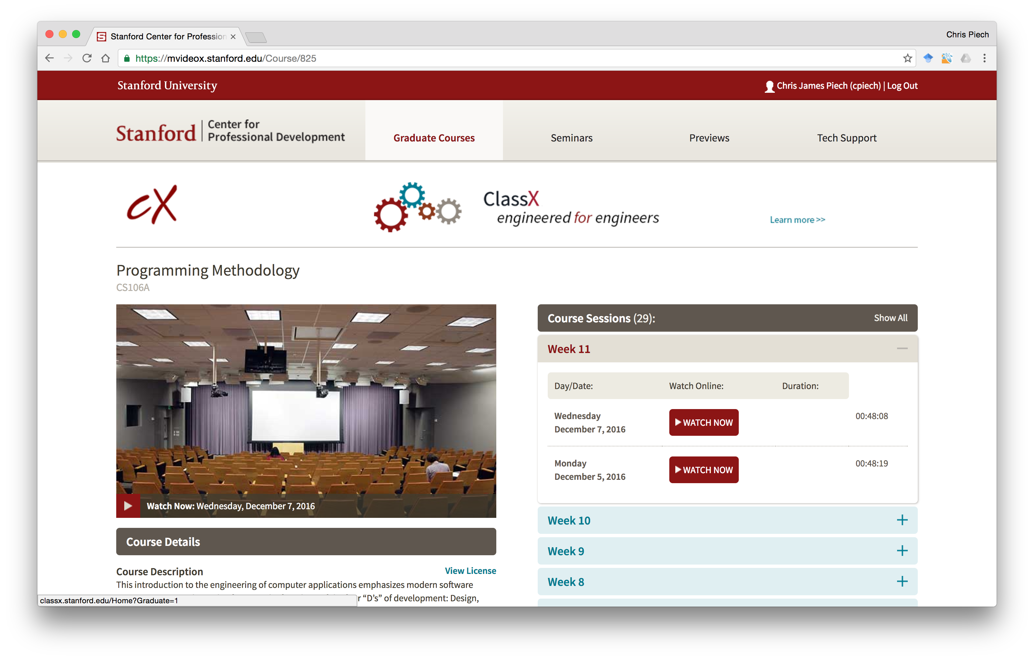
Lectures are Online

Slide 18
Are you in the right place?

Slide 19
What is CS106A?

Slide 20
Computer Science
Computer science is no more about computers than astronomy is about telescopes, biology is about microscopes or chemistry is about beakers and test tubes. Science is not about tools, it is about how we use them and what we find out when we do.
- Michael Fellows and Ian Parberry

Slide 21
Learning Goals
Learn how to harness computing power to solve problems.
To that end:
Explore fundamental techniques in computer programming.
Develop good software engineering style.
Gain familiarity with the Java programming language.

Slide 22
There are a lot of cool programs you may one day write

Slide 23
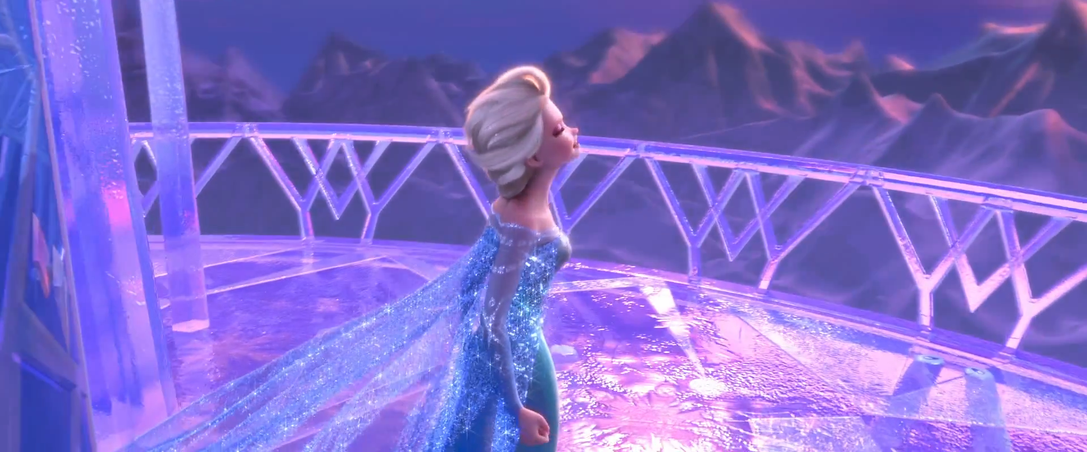
Computer Graphics
Pat Hanrahan, one of the founders of Pixar is a professor here

Slide 24
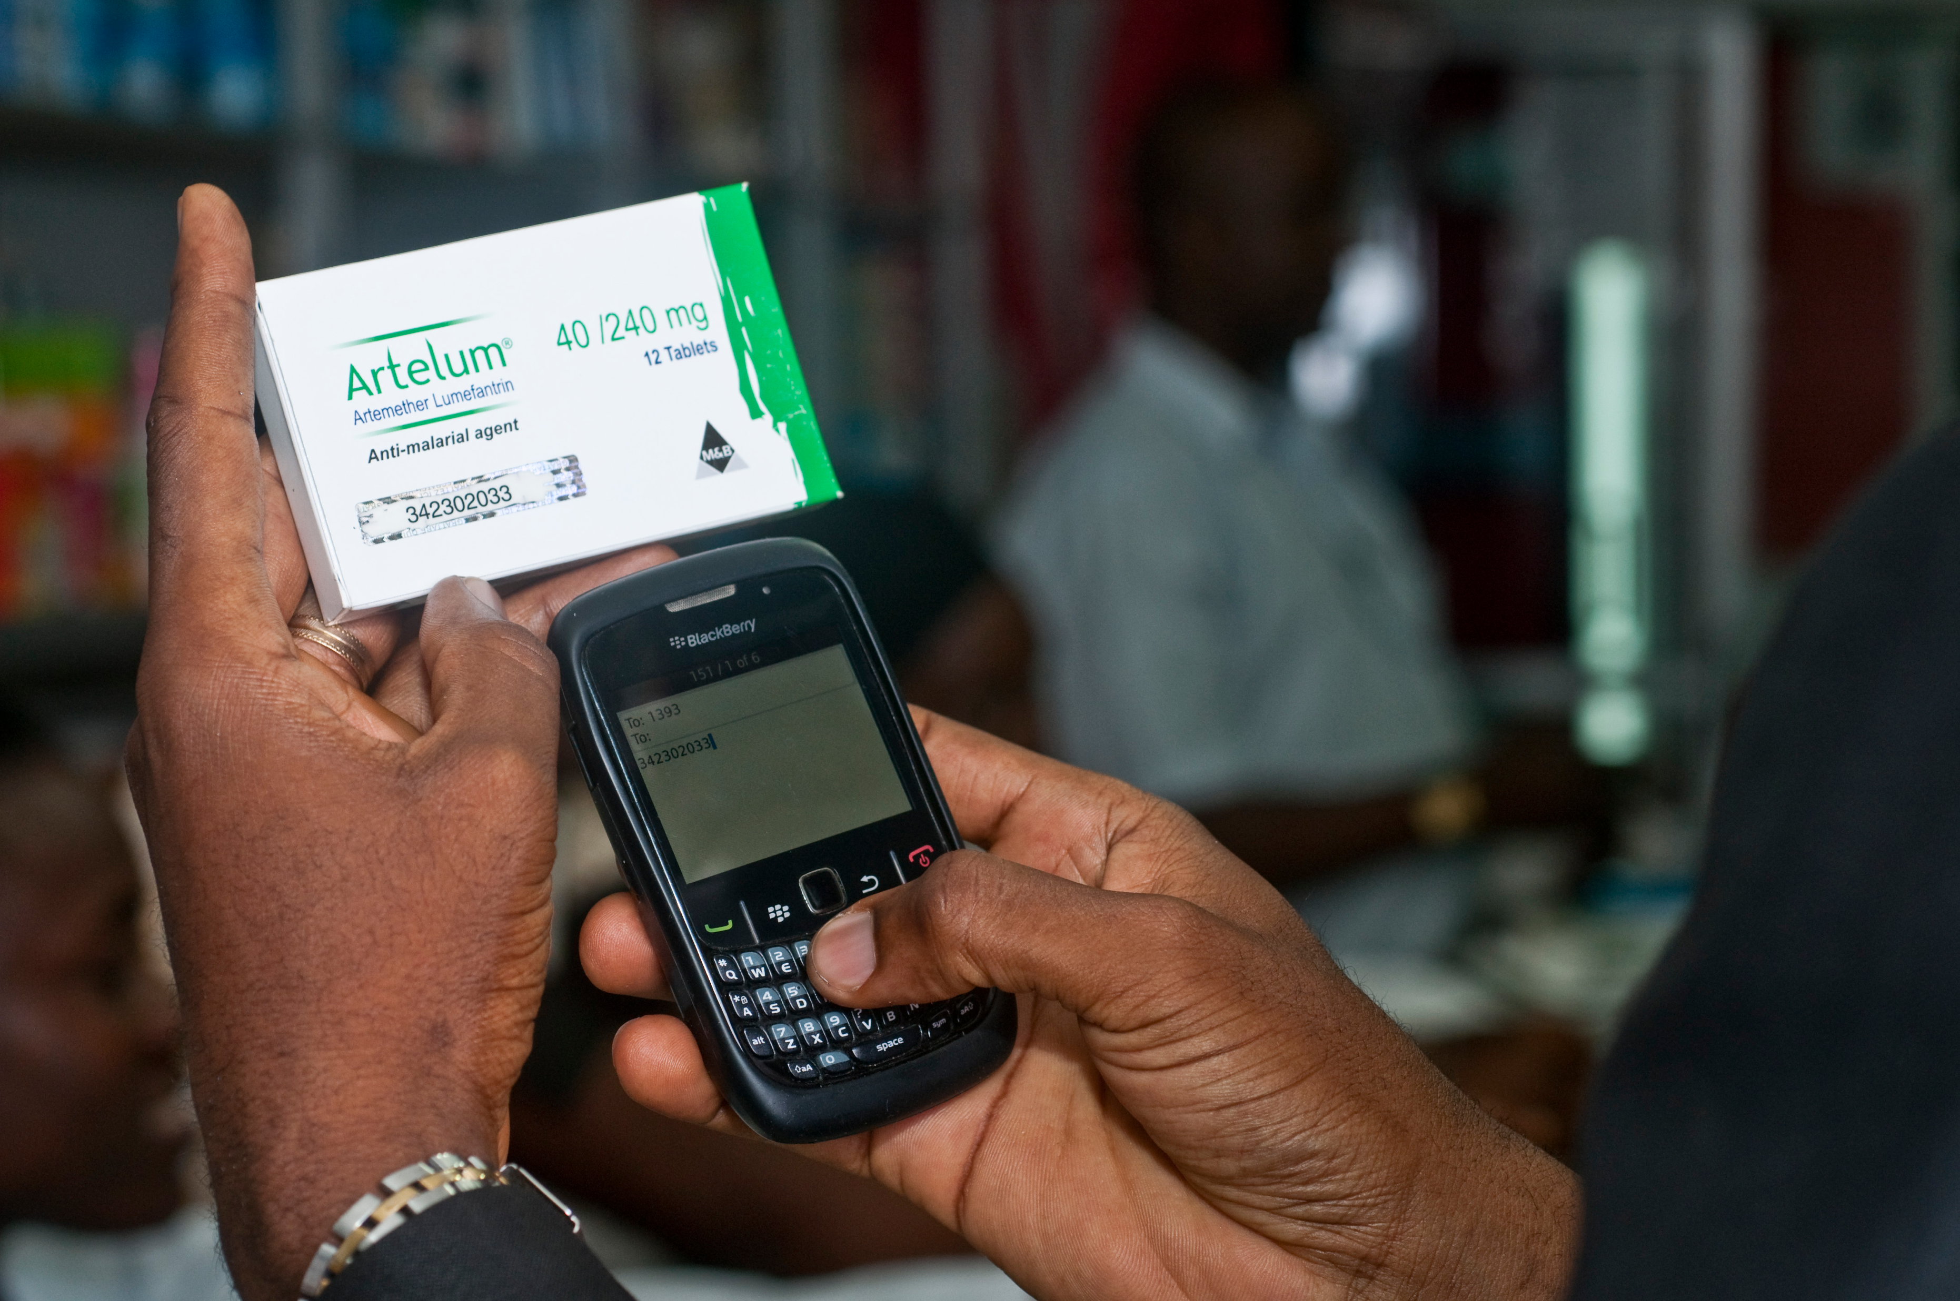
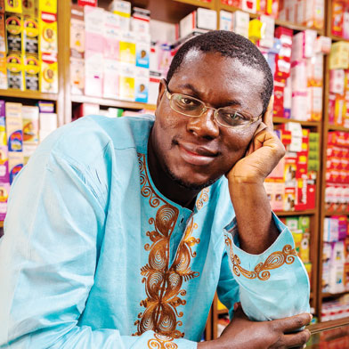
Consumer Applications
Notes:
Estimated 700,000 deaths from fame malaria and TB drugs in 2013:
http://www.un.org/africarenewal/magazine/may-2013/counterfeit-drugs-raise-africa%E2%80%99s-temperature
Bright Simmons from Ghana made an application which let people verify if their medication was authentic

Slide 25
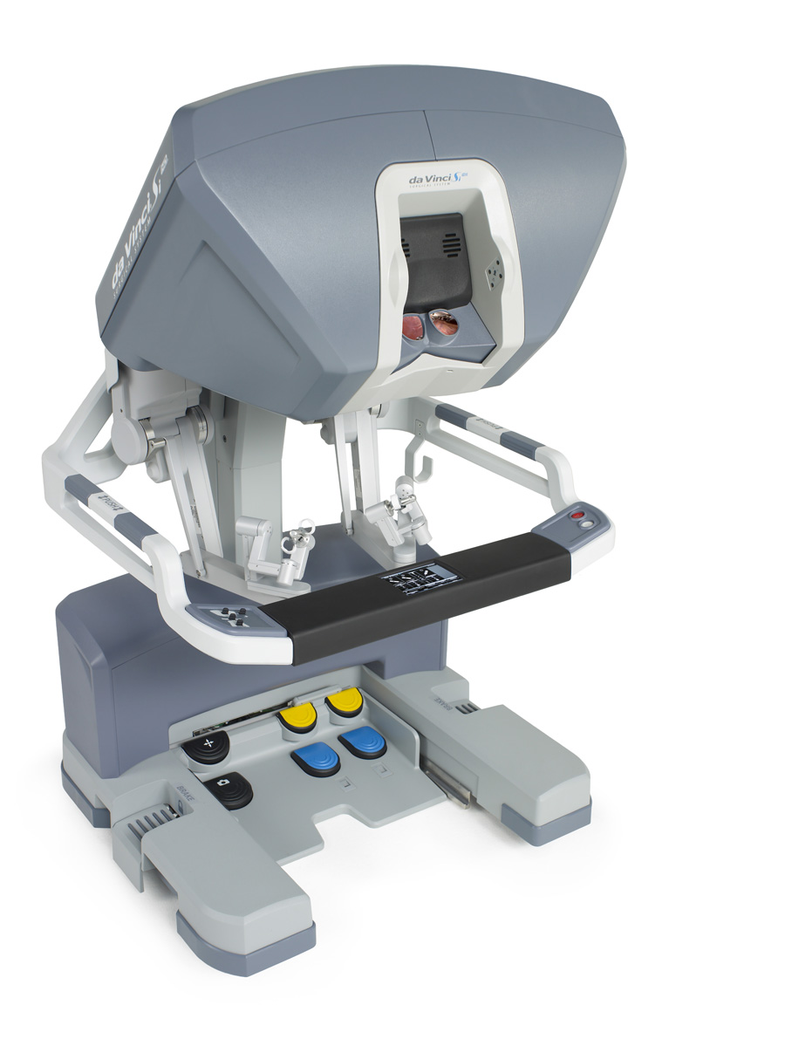
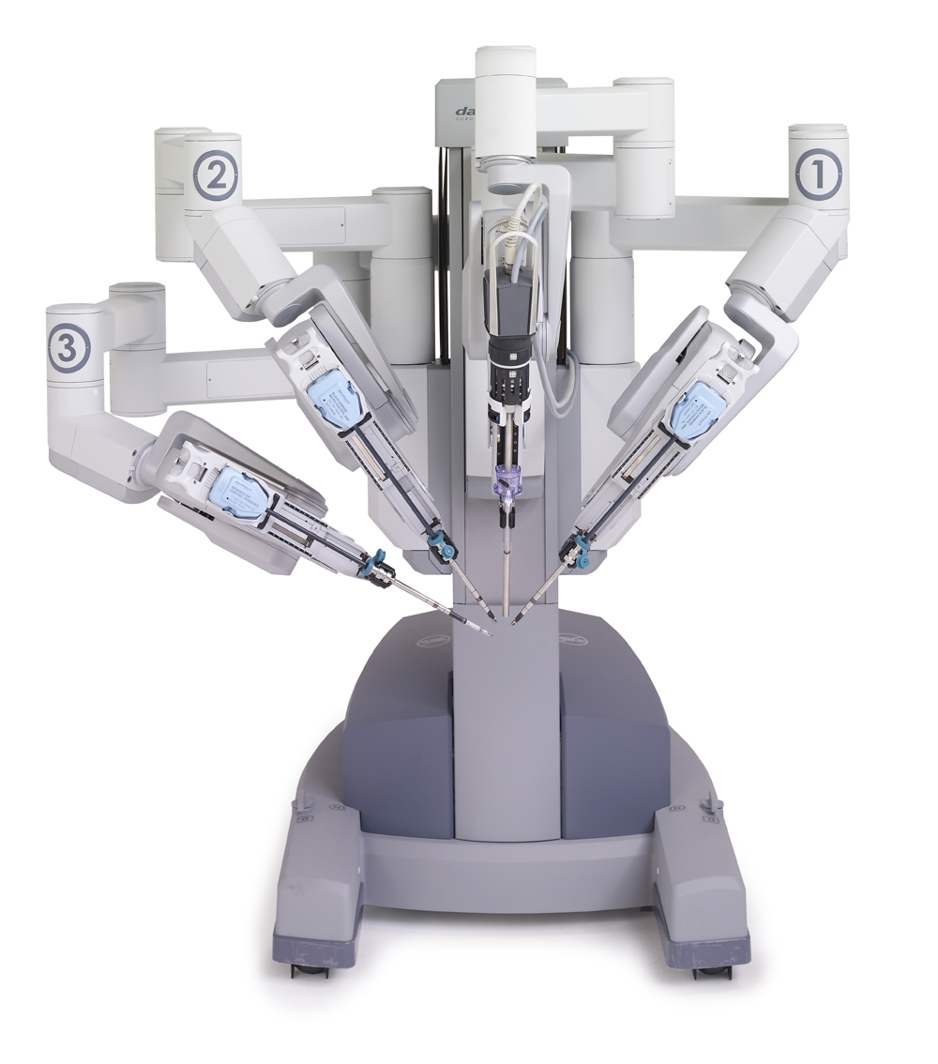
Autonomous Surgery
(c) 2012 Intuitive Surgical, Inc.

Slide 26
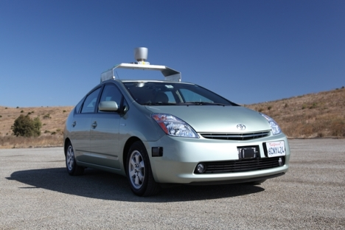
Self Driving Car

Slide 27
If only we could program self driving cars…

Slide 28
Graphical Games

Slide 29
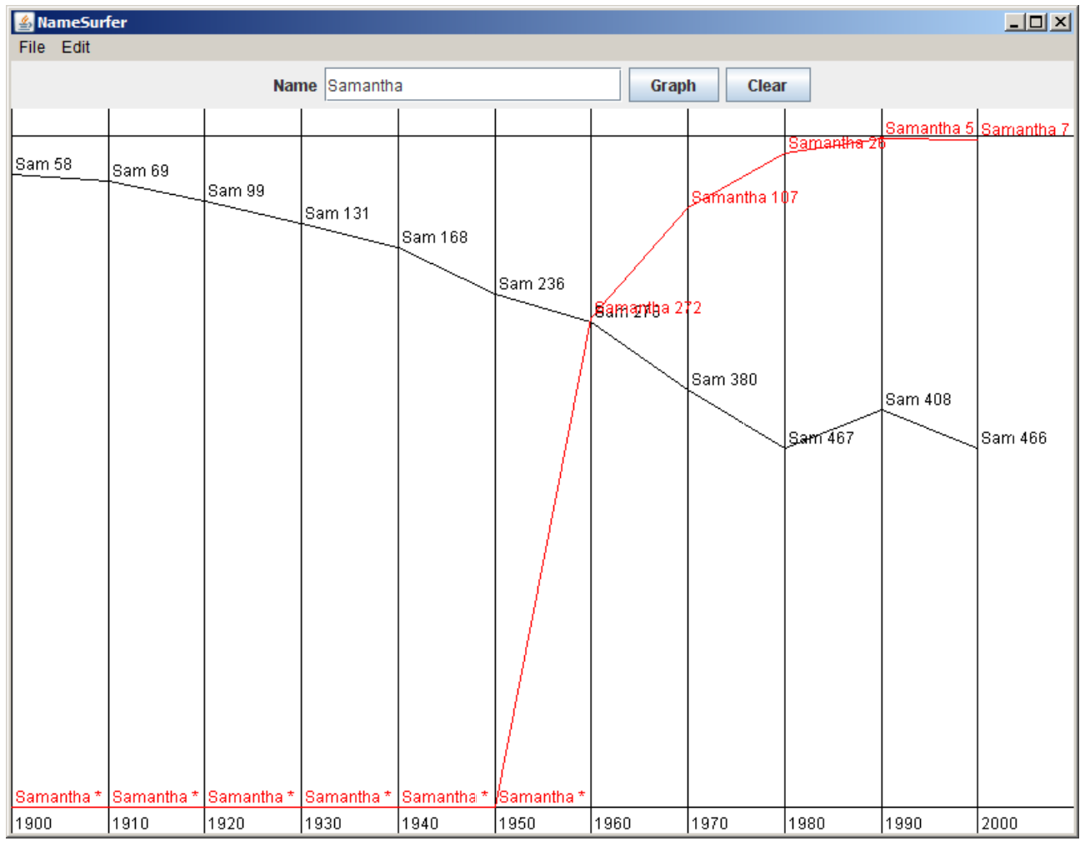
Data Visualization

Slide 30
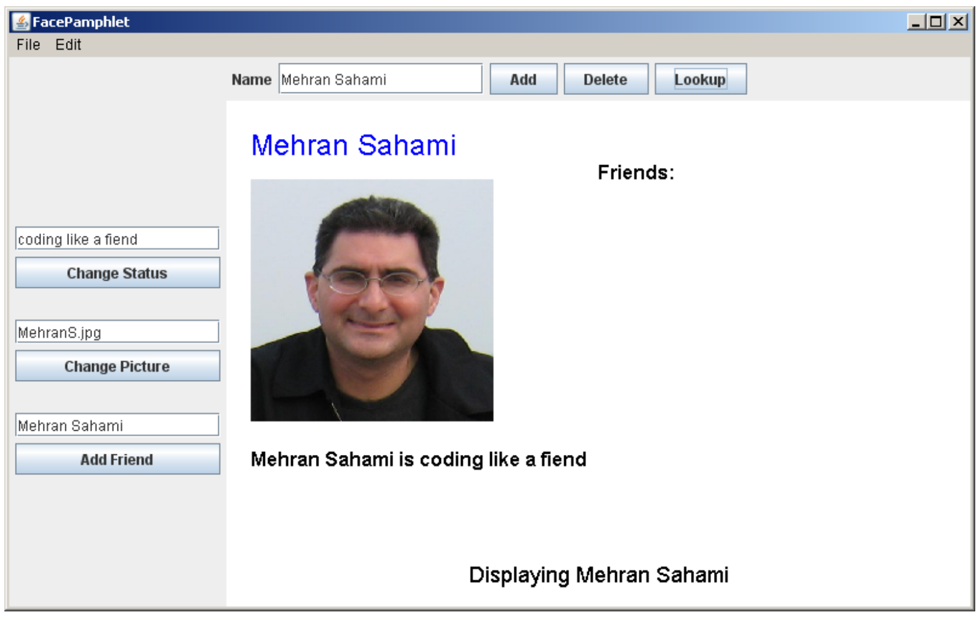
Mini Facebook

Slide 31
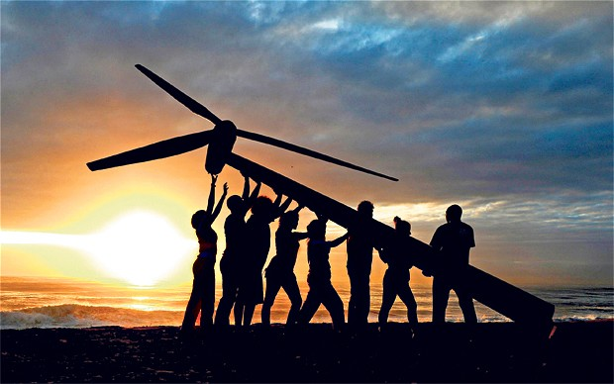
Strive for Everyone to Succeed
Notes:
We want all of you to be successful
That’s why we have such a large course staff
And its not like it’s a ya-ya course where we all hold hands and sing koombaya. Its real material.
But over years and years and years we have been working on our material so that everyone gets through…
Not competing against anyone but yourself

Slide 32
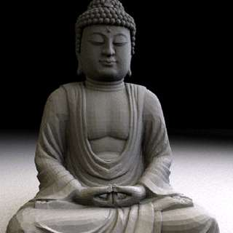
Art of Computer Science
Notes:
We teach software engineering principles. Much larger than just programming.
Mechanics of the language are nothing compared to the principles.
You are going to learn the principles by programming in Java

Slide 33
Something cool

Slide 34
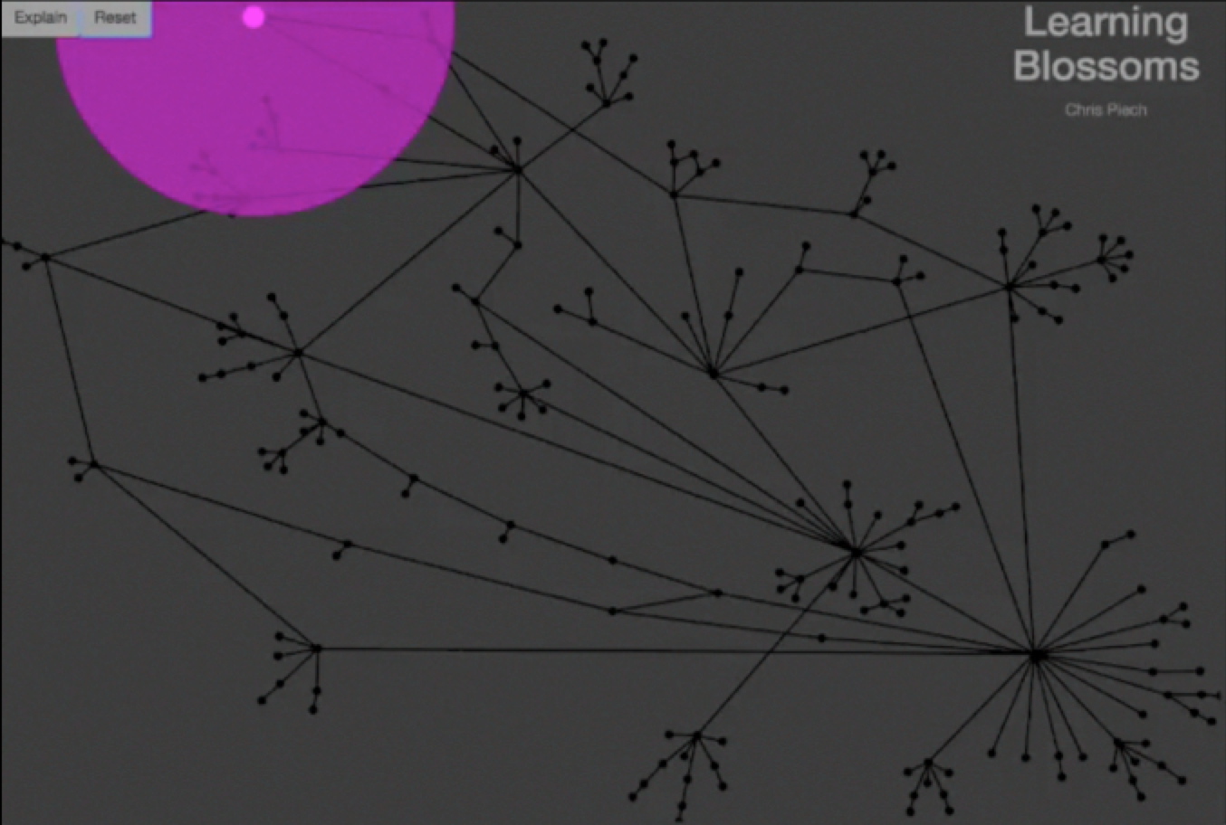
Autonomously Generating Hints by Inferring Problem Solving Policies
Chris Piech, Mehran Sahami, Jonathan Huang, Leo Guibas

Slide 35
Each edge is what a teacher suggested
Pink dots are students.
Each node is a unique intermediate solution
Solution
Autonomously Generating Hints by Inferring Problem Solving Policies
Chris Piech, Mehran Sahami, Jonathan Huang, Leo Guibas

Slide 36
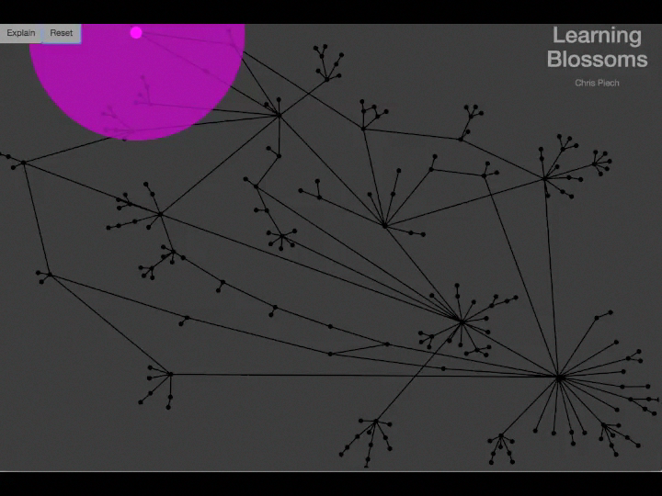
Autonomously Generating Hints by Inferring Problem Solving Policies
Chris Piech, Mehran Sahami, Jonathan Huang, Leo Guibas

Slide 37
Process Predicts Future
We want to help you learn the process of programming
Problem A
Problem B
Effect is large and logrithmic.

Slide 38
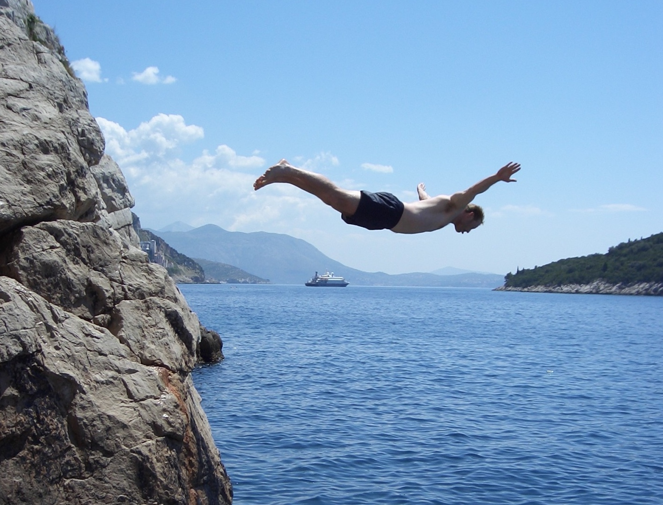
Lets Get Started

Slide 39
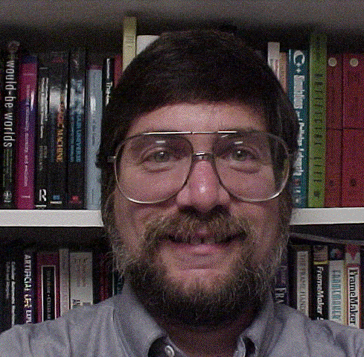

Meet Karel the Robot
Good morning
Notes:
He looks like an old machintosh machine.
Hes got legs… one sticks out the back. That’s just the way it is.

Slide 40
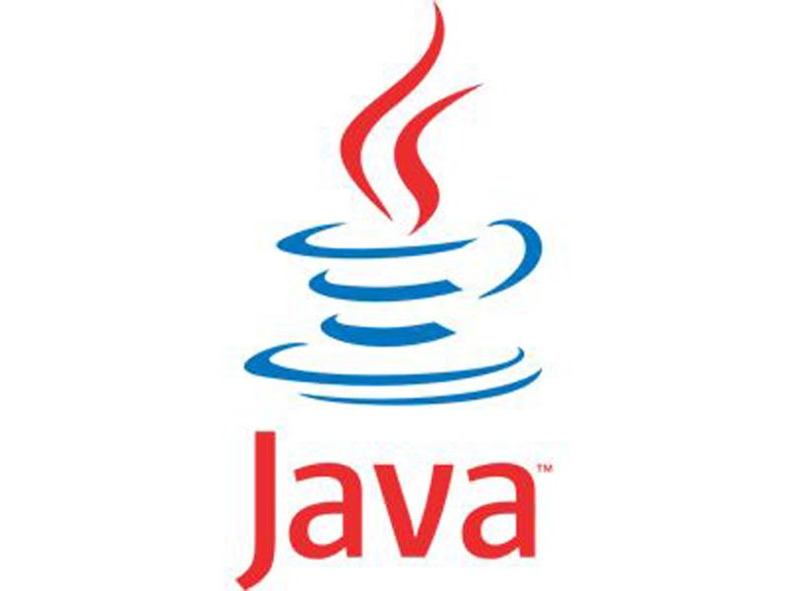
Karel Speaks Java
s
Notes:
Tomorrow you will learn that Karel is actually a very gentle introduction to programming

Slide 41
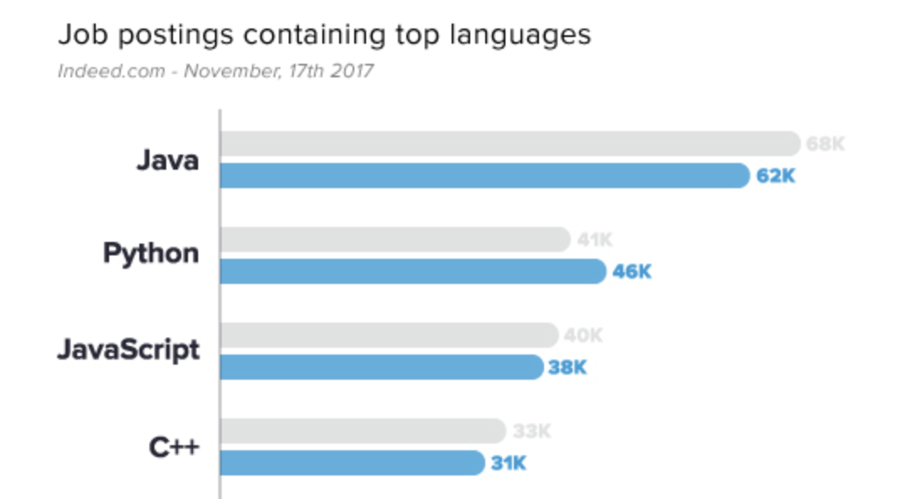
Why Java?
1
2
http://www.codingdojo.com/blog/7-most-in-demand-programming-languages-of-2018/

Slide 42

Karel’s World
North
3
+
+
+
+
+
2
+
+
+
+
+
West
East
1
+
+
+
+
+
South
1
2
3
4
5
Notes:
To you it might not be exciting but to karel its very exciting.

Slide 43

Walls
3
+
+
+
+
2
+
+
+
+
1
+
+
+
+
1
2
3
4

Slide 44

Beepers
3
+
+
+
+
2
+
+
+
+
1
+
+
+
+
1
2
3
4

Slide 45
Knows Four Commands
move();
turnLeft();
putBeeper();
pickBeeper();
Notes:
Tomorrow you will learn that Karel is actually a very gentle introduction to programming

Slide 46
move();

Slide 47

move();
3
+
+
+
+
2
+
+
+
+
1
+
+
+
+
1
2
3
4

Slide 48
move();
3
+
+
+
+
2
+
+
+
+
1
+
+
+
+
+
1
2
3
4

Slide 49
turnLeft();

Slide 50
turnLeft();
3
+
+
+
+
2
+
+
+
+
1
+
+
+
+
+
1
2
3
4

Slide 51
turnLeft();
3
+
+
+
+
2
+
+
+
+
1
+
+
+
+
+
1
2
3
4

Slide 52
pickBeeper();

Slide 53
pickBeeper();
3
+
+
+
+
2
+
+
+
+
1
+
+
+
+
+
1
2
3
4

Slide 54
pickBeeper();
3
+
+
+
+
2
+
+
+
+
1
+
+
+
+
+
1
2
3
4

Slide 55
Make Sense?

Slide 56
First Challenge
3
+
+
+
+
2
+
+
+
+
1
+
+
+
+
1
2
3
4

Slide 57
First Challenge
3
+
+
+
+
2
+
+
+
+
1
+
+
+
+
1
2
3
4

Slide 58
Bird’s Eye View
3
+
+
+
+
2
+
+
+
+
1
+
+
+
+
1
2
3
4
Karel is facing East

Slide 59
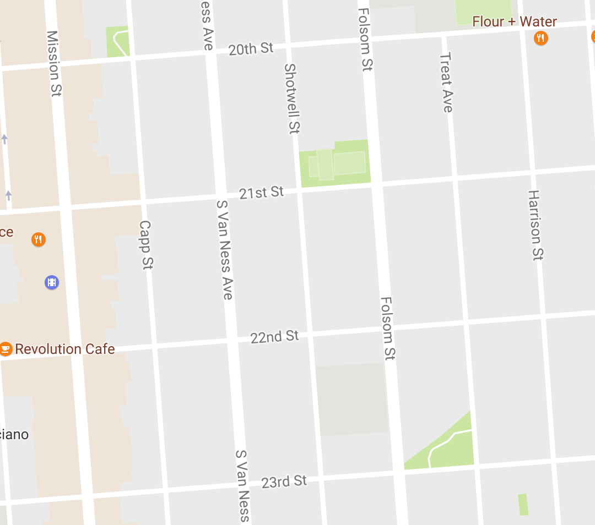
Bird’s Eye View
Karel is facing East

Slide 60
Turn Left
Karel is facing North

Slide 61
Turn Left
Karel is facing West

Slide 62
Turn Left
Karel is facing South

Slide 63
Move

Slide 64
First Challenge
3
+
+
+
+
2
+
+
+
+
1
+
+
+
+
1
2
3
4

Slide 65
First Challenge
3
+
+
+
+
2
+
+
+
+
1
+
+
+
+
1
2
3
4

Slide 66
First Challenge
3
+
+
+
+
2
+
+
+
+
1
+
+
+
+
1
2
3
4

Slide 67

Learn By Doing

Slide 68


Slide 69
Method Definition
private void name() {
method statements
}
This adds a new command to Karels vocabulary

Slide 70
Anatomy of a Program
Import Packages
Program

Slide 71
Anatomy of a Program
Import Packages
public class OurKarelProgram extends Karel {
}

Slide 72
Anatomy of a Program
Import Packages
public class OurKarelProgram extends Karel {
}
run method
helper methods

Slide 73
Anatomy of a Program
Import Packages
public class OurKarelProgram extends Karel {
}
public void run() {
move();
pickBeeper();
move();
turnLeft();
move();
turnRight();
move();
putBeeper();
move();
}
helper methods

Slide 74
Anatomy of a Program
Import Packages
public class OurKarelProgram extends Karel {
}
public void run() {
move();
pickBeeper();
move();
turnLeft();
move();
turnRight();
move();
putBeeper();
move();
}
private void turnRight() {
turnLeft();
turnLeft();
turnLeft();
}

Slide 75
Anatomy of a Program
import stanford.karel.*;
public class OurKarelProgram extends Karel {
}
public void run() {
move();
pickBeeper();
move();
turnLeft();
move();
turnRight();
move();
putBeeper();
move();
}
private void turnRight() {
turnLeft();
turnLeft();
turnLeft();
}

Slide 76
Anatomy of a Program
import stanford.karel.*;
public class OurKarelProgram extends Karel {
}
public void run() {
move();
pickBeeper();
move();
turnLeft();
move();
turnRight();
move();
putBeeper();
move();
}
This piece of the program's source code is called a method.
private void turnRight() {
turnLeft();
turnLeft();
turnLeft();
}

Slide 77
Anatomy of a Program
import stanford.karel.*;
public class OurKarelProgram extends Karel {
}
public void run() {
move();
pickBeeper();
move();
turnLeft();
move();
turnRight();
move();
putBeeper();
move();
}
x
This line of code gives the name of the method
(here, run)
private void turnRight() {
turnLeft();
turnLeft();
turnLeft();
}

Slide 78
Anatomy of a Program
import stanford.karel.*;
public class OurKarelProgram extends Karel {
}
public void run() {
move();
pickBeeper();
move();
turnLeft();
move();
turnRight();
move();
putBeeper();
move();
}
This line of code gives the name of the method
(here, turnRight)
private void turnRight() {
turnLeft();
turnLeft();
turnLeft();
}

Slide 79
Anatomy of a Program
import stanford.karel.*;
public class OurKarelProgram extends Karel {
}
public void run() {
move();
pickBeeper();
move();
turnLeft();
move();
turnRight();
move();
putBeeper();
move();
}
This is called a code block
private void turnRight() {
turnLeft();
turnLeft();
turnLeft();
}

Slide 80
Anatomy of a Program
import stanford.karel.*;
public class OurKarelProgram extends Karel {
}
public void run() {
move();
pickBeeper();
move();
turnLeft();
move();
turnRight();
move();
putBeeper();
move();
}
This is called a code block
private void turnRight() {
turnLeft();
turnLeft();
turnLeft();
}

Slide 81
Anatomy of a Program
import stanford.karel.*;
public class OurKarelProgram extends Karel {
}
public void run() {
move();
pickBeeper();
move();
turnLeft();
move();
turnRight();
move();
putBeeper();
move();
}
This is also called a code block
private void turnRight() {
turnLeft();
turnLeft();
turnLeft();
}

Slide 82
Anatomy of a Program
import stanford.karel.*;
public class OurKarelProgram extends Karel {
}
public void run() {
move();
pickBeeper();
move();
turnLeft();
move();
turnRight();
move();
putBeeper();
move();
}
private void turnRight() {
turnLeft();
turnLeft();
turnLeft();
}

Slide 83
Anatomy of a Program
import stanford.karel.*;
public class OurKarelProgram extends Karel {
}
public void run() {
move();
pickBeeper();
move();
turnLeft();
move();
turnRight();
move();
putBeeper();
move();
}
The run method is “public” so that Eclipse can call it.
private void turnRight() {
turnLeft();
turnLeft();
turnLeft();
}

Slide 84
Anatomy of a Program
import stanford.karel.*;
public class OurKarelProgram extends Karel {
}
public void run() {
move();
pickBeeper();
move();
turnLeft();
move();
turnRight();
move();
putBeeper();
move();
}
The turnRight method is “private” to indicate it is only visible to our current program.
private void turnRight() {
turnLeft();
turnLeft();
turnLeft();
}

Slide 85
Why Study CS?

Slide 86
Joy of Building

Slide 87
Interdisciplinary

Slide 88

Closest Thing To Magic

Slide 89
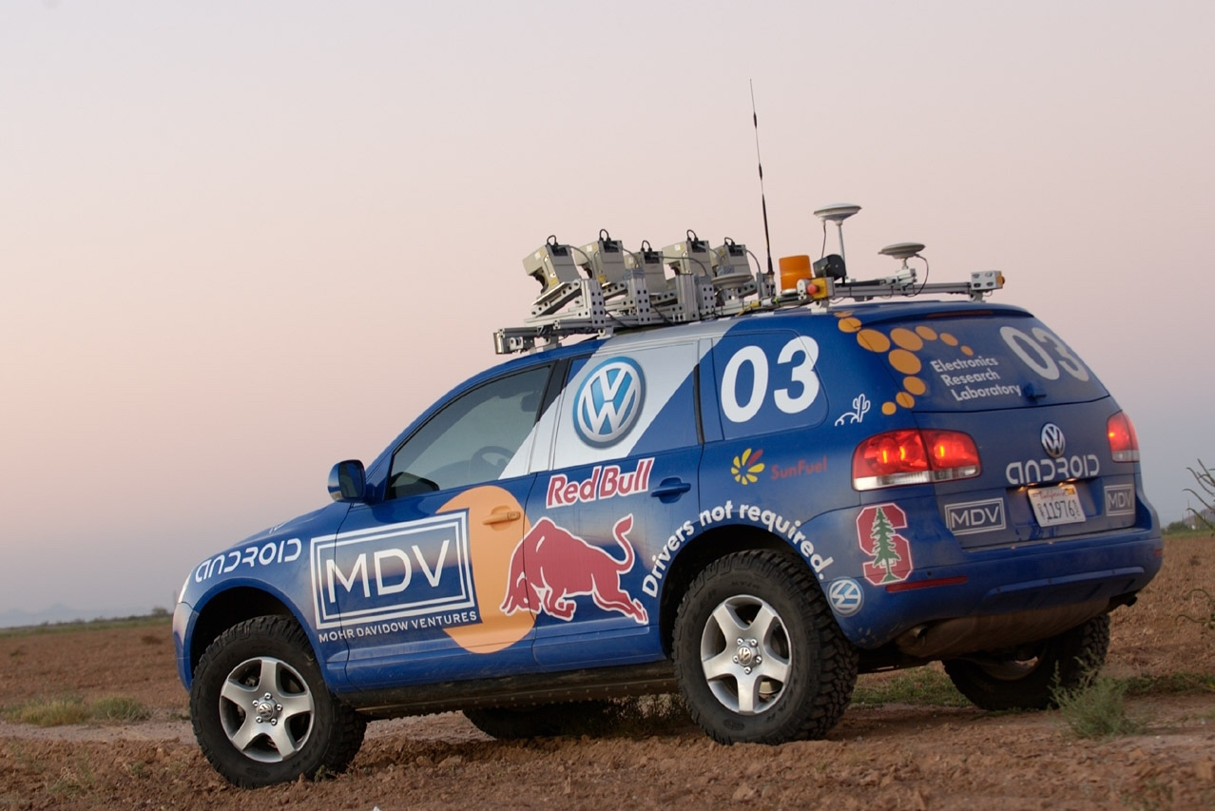

Now is the Time

Slide 90
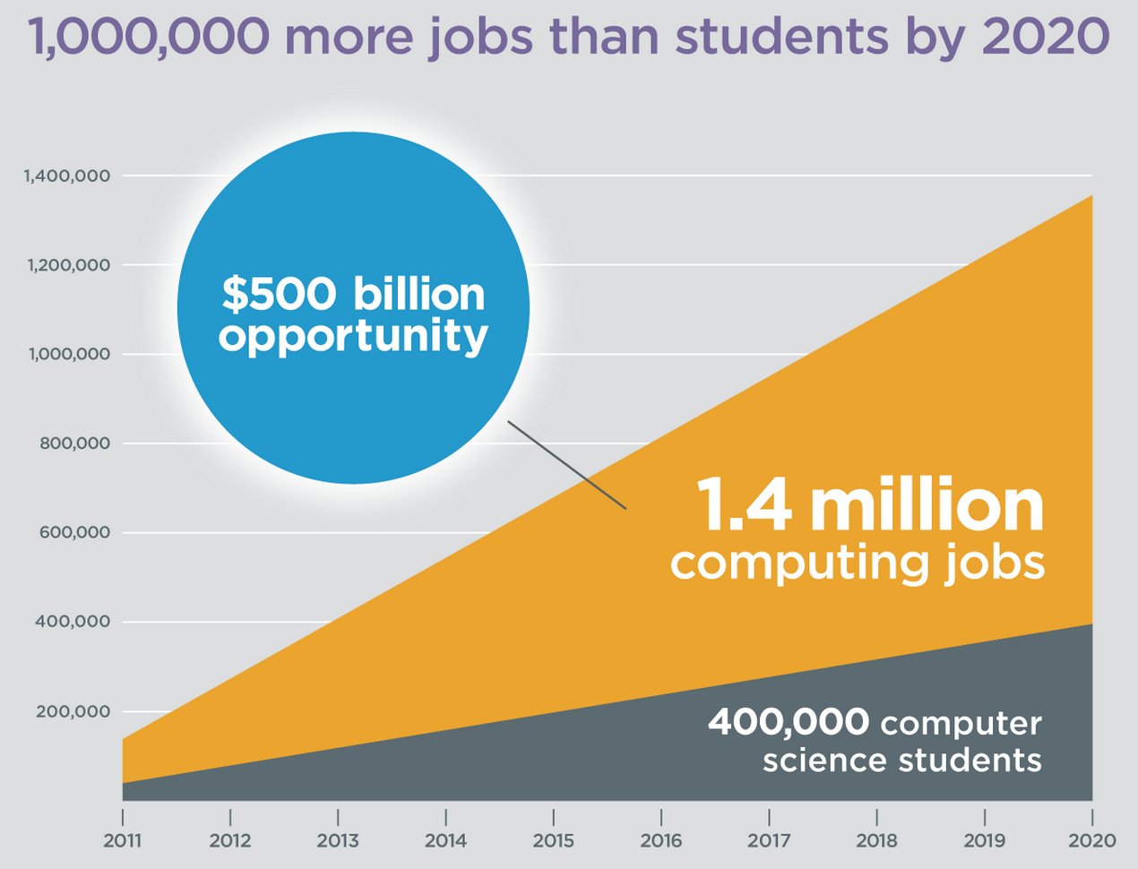
Oh and Its Useful
Code.org

Slide 91
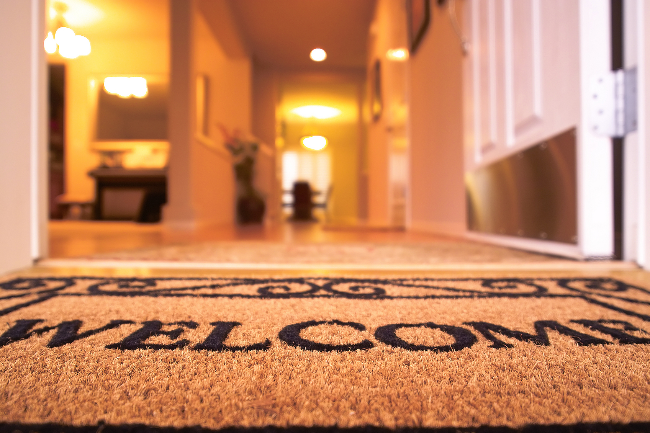
Everyone is Welcome
Notes:
One of my favorite things about programming is that we are all equal infront of Eclispe.
Eclipse does not care your ethnicity, gender, orientation.
That theme is part of the essence of CS106A.
Last night Oprah talked about the new day that is on the horizon! CS too is having a new day and it is very exciting future for the phenomenal women and men sitting in this classroom.

Slide 92
The End

Slide 93
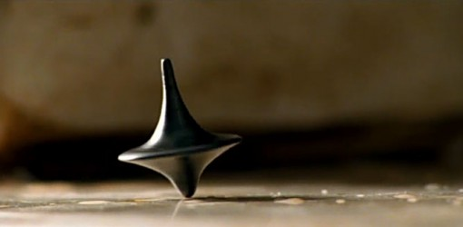
The End?

